Slide 1
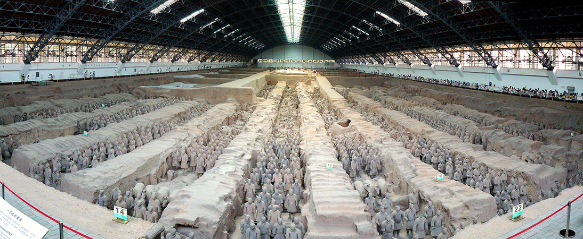
Science & Technology in China and Japan
Dr. Driggers
HIST 1310
STUDENT View

Slide 2
Agenda
Survey of the history of science in Medieval China, then turning our attention to Japan
Remember to conslult your book—I have a short lecture ppt that describes how you should take notes per each chapter.
This lecture is on a new frontier of the history of science—I will include a bibliography for further reading (for your own edification)

Slide 3
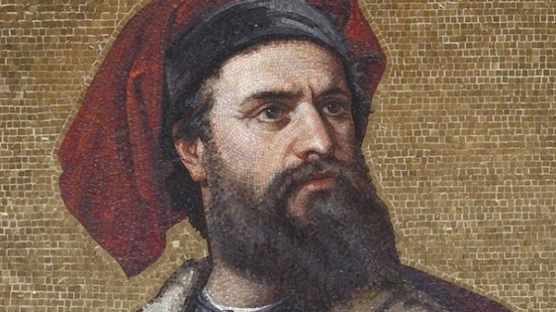
A Story You’re probably familiar with….

Slide 4

Perhaps you’ve seen some things…

Slide 5
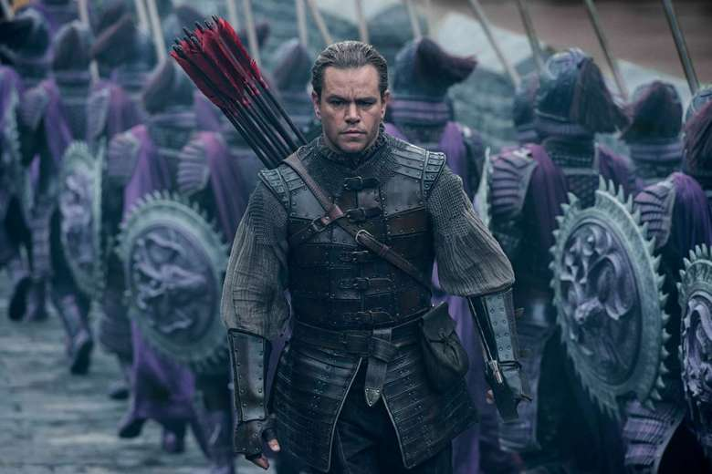
But then again, there are controversies…

Slide 6
Our Approach to Chinese History has to be done carefully
Background of Marco Polo
“The Travels of Marco Polo” published in 1300
How do we know Polo wasn’t stretching things a bit…
Let’s look at the details!

Slide 7
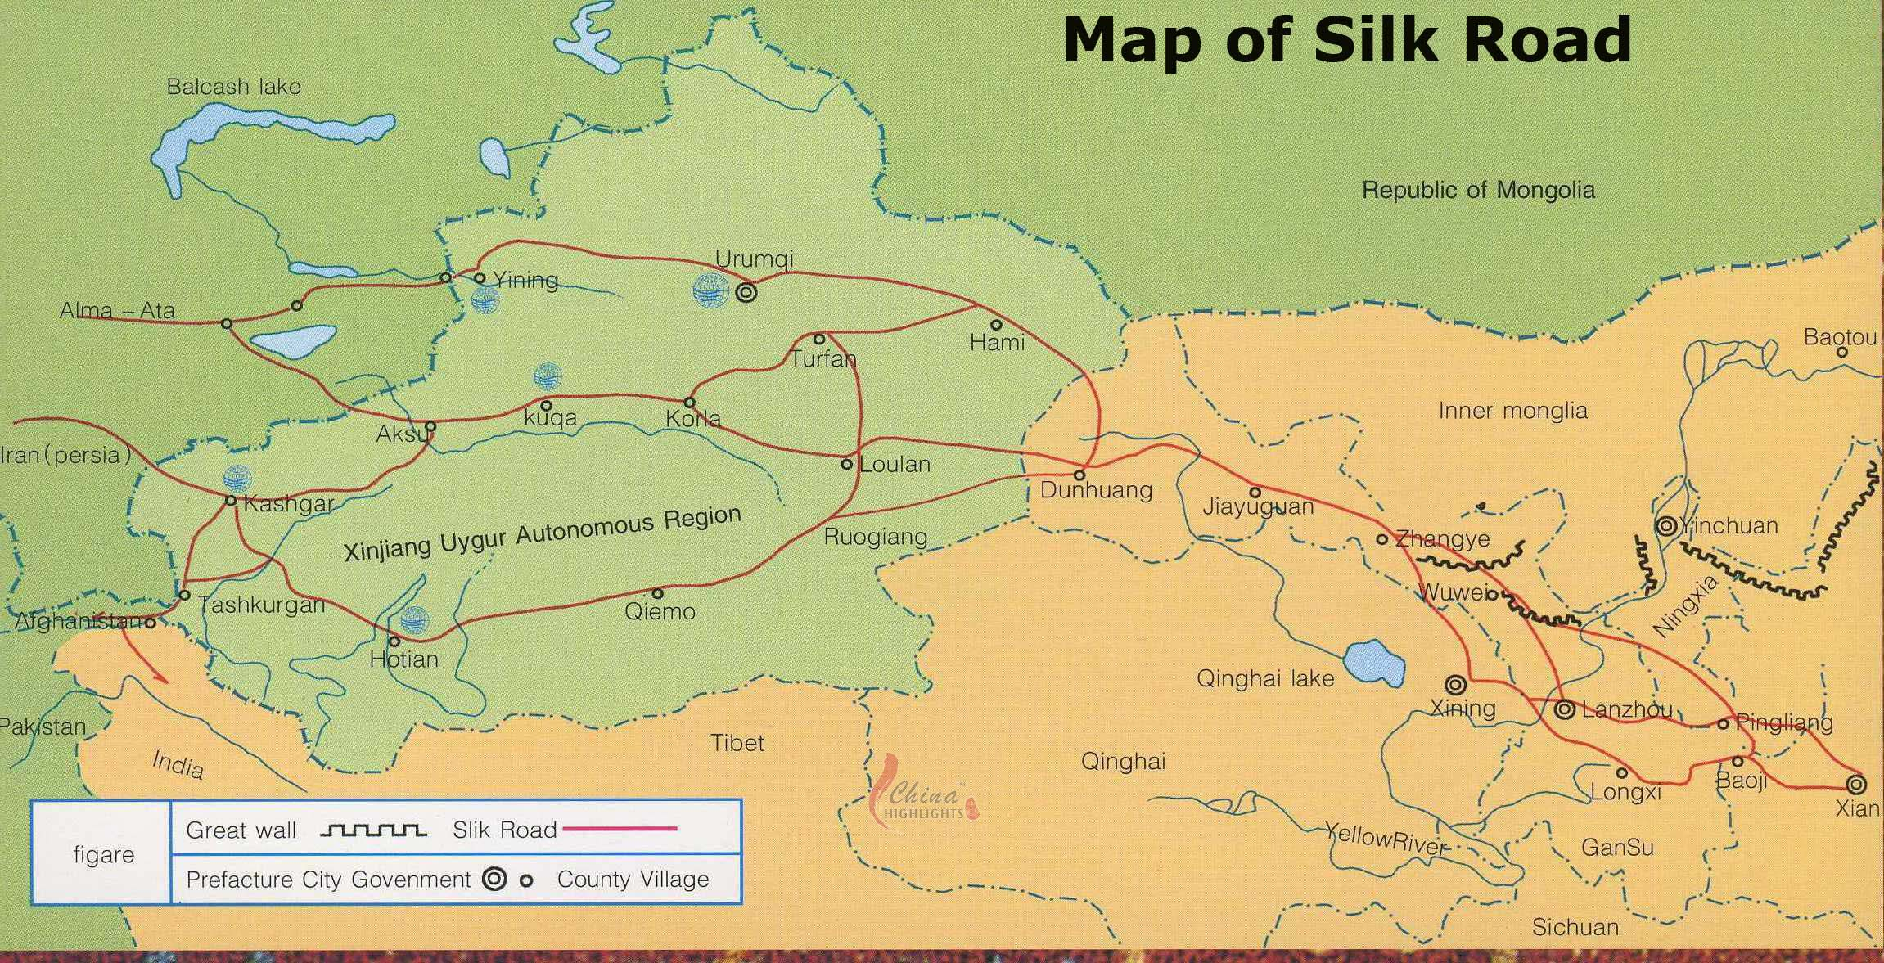
Silk Road

Slide 8
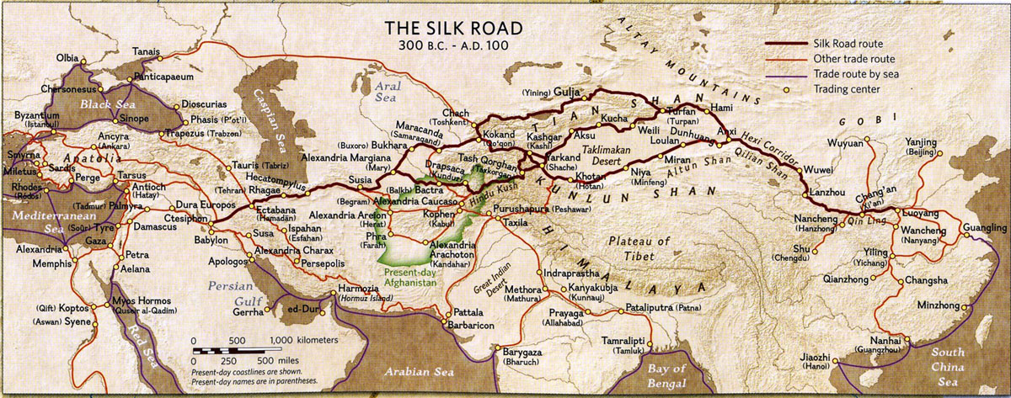
The Silk Road 2

Slide 9
From Chapter 38 of the Description of the World
“In the country is found a briny earth; upon this, when laid in large heaps, they pour water, which in its passage through the mass imbibes the particles of salt, and is then collected in channels, from whence it is conveyed to a very wide pans, not more than four inches in depth. In these, it is well broiled, and then left crystalize. The salt thus made is wheite and good, and is exported ot various parts of the whole nation.”

Slide 10
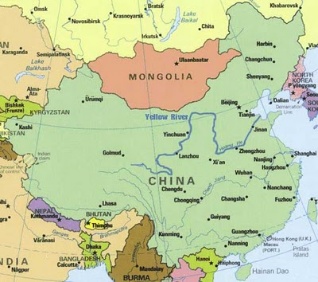
Ancient China in Context—Using a Newish Map

Slide 11
Introduction to Ancient China
Names for China:
Ancient Indian Civilizations: Cinah (Cheena) in Sanskirt
Medieval Europe: Cathay
In 1516 the Portuguese explorer Duarte Barbosa called it “the very great Kingdom of China”

Slide 12
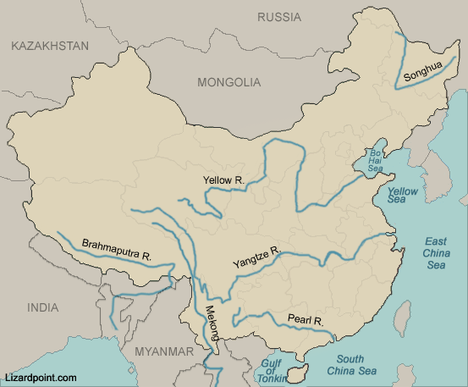
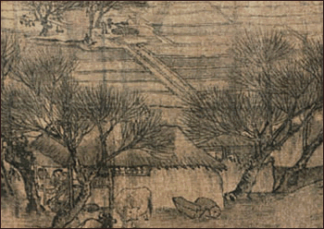
An Empire of Vast Wealth Coming from Rivers!

Slide 13
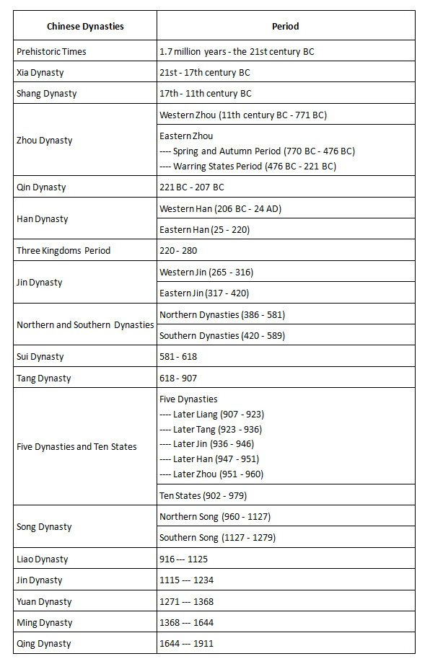
History—Mostly in Dynasties

Slide 14
China: Adminstration and Education
General Remarks on Chinese History
Administration:
the exam!
Confucianism!
However, science was not overlooked!
Society was a mixture of secular and religious aspect

Slide 15
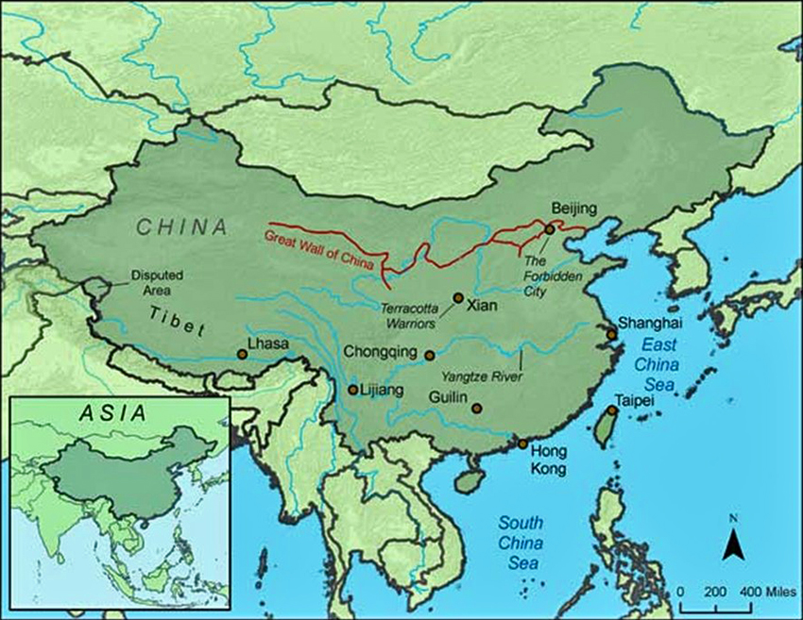
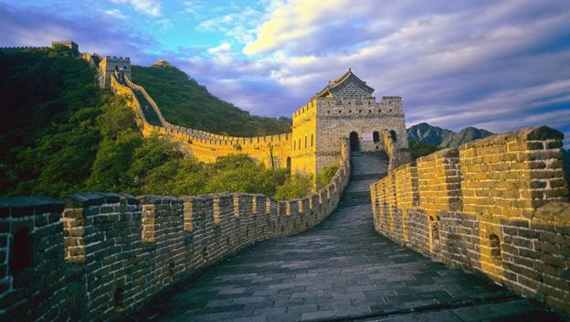
Qin Technology in the Great Wall and Terra-Cotta Army

Slide 16
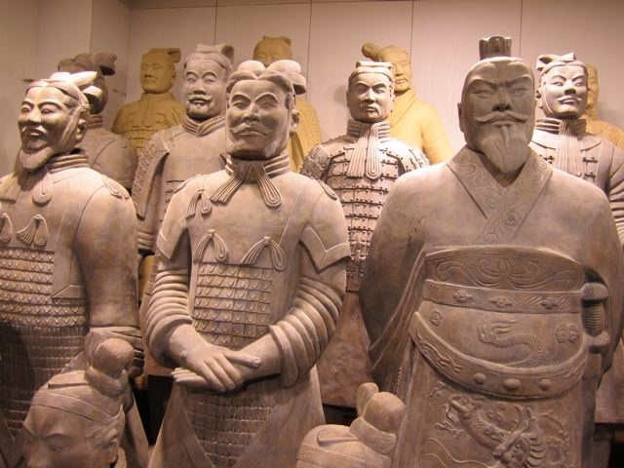
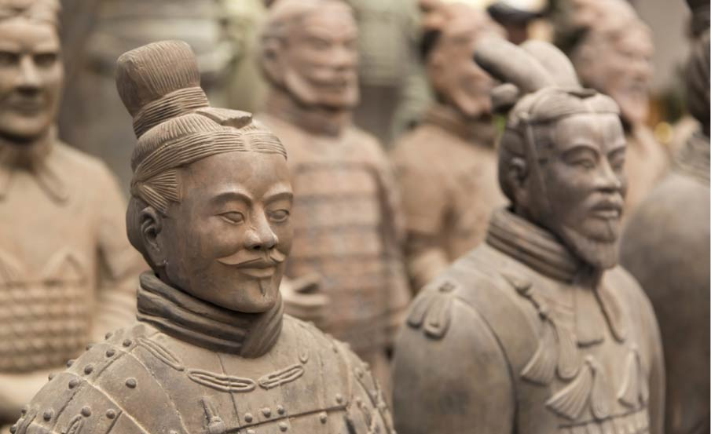
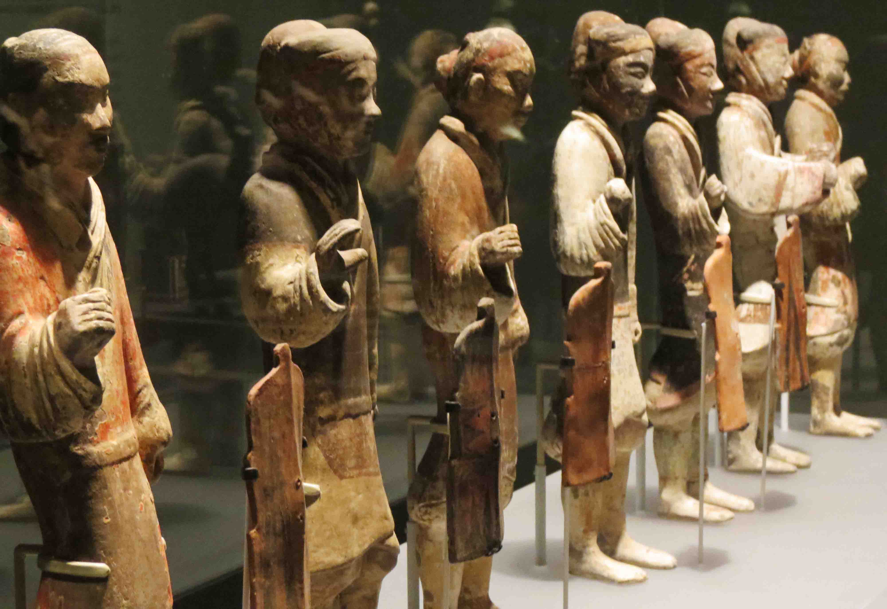
Terracotta Warriors

Slide 17
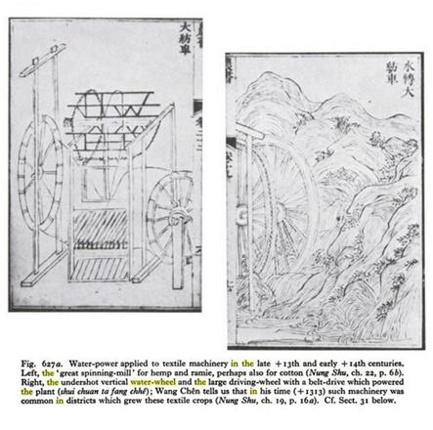
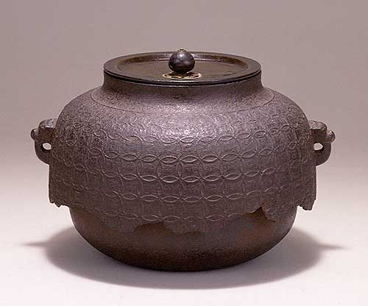
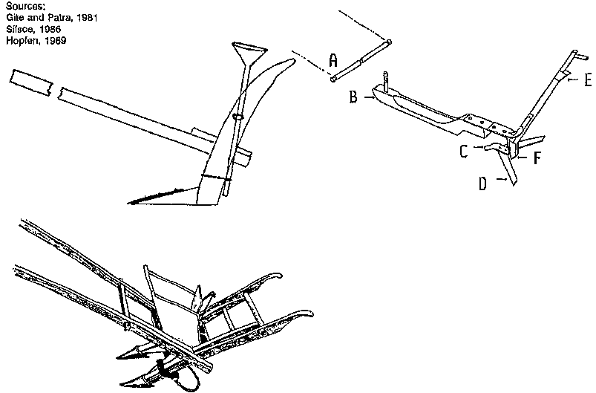
Han Dynasties—Some Innovations

Slide 18
Chinese Medicine
Very Old Tradition
Tang Dynasty (618-907 CE)—Movement of Blood and the Hearth
Long Time—Perhaps Effective?
Also called TCM (Traditional Chinese Medicine)
Empahsis on Whole Person

Slide 19
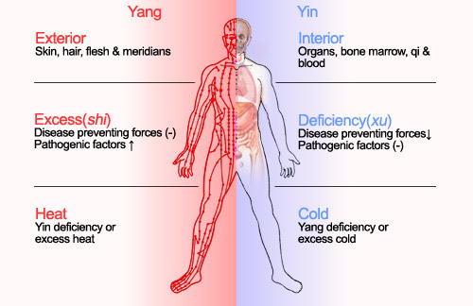
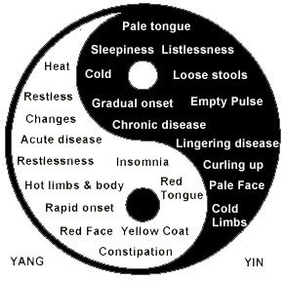
Theoretical Framework –Ying and Yang

Slide 20
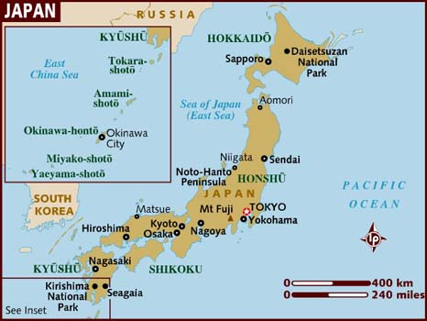
Transition to Japan

Slide 21
General Notes About Japan
Would like to Talk About Feudal Japan (1158-1600)
BUT the historiography really takes off in //1543-1639 Period of initial European contact
LOTS of historiography about 20th Century Japanese Science
Prior to European Encounters, scholars write of derivative science in Japan, or science only serving the Shugonate Bureaucracy—often written like older accounts of Medieval European Science
See for example: “The Penetration of the Copernican Theory into Feudal Japan, Bolesław Szcześniak, The Journal of the Royal Asiatic Society of Great Britain and IrelandNo. 1 (Apr., 1944), pp. 52-61

Slide 22

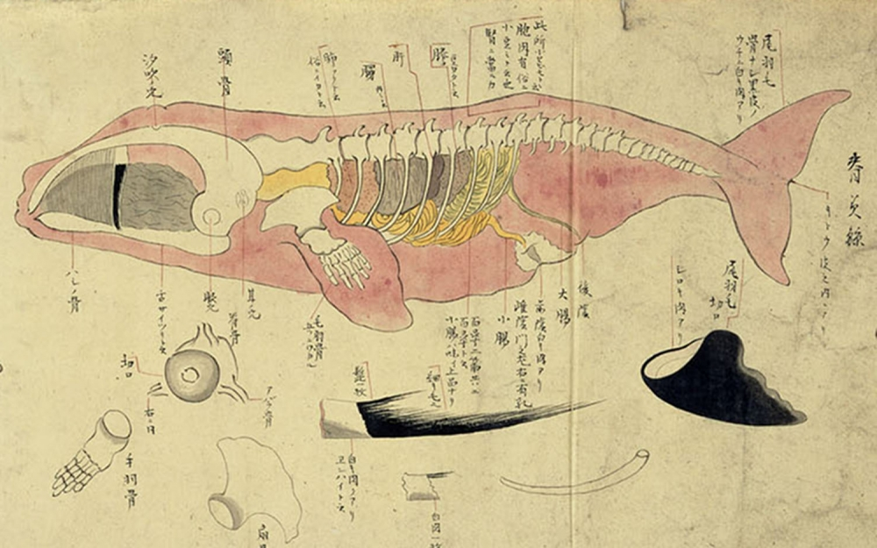
One Book Challenging This//Other Scholarship

Slide 23
Want to know more? For your own edification?
Feel free to e-mail me; tell me what subjects and places you’re interested in!

